Slide 1

Predicting health insurance claims in the USA

Slide 2

Objective
This project seeks to predict future insurance claims and identify factors that lead to higher healthcare costs, which could result in significant cost reductions for insurance providers in the USA, and the role of artificial intelligence in the form of machine learning with regards to healthcare insurance claim processing

Slide 3

What model can be used to predict an efficient insurance claim process for a customer?
Which variable could be analyzed to anticipate insurance claims more accurately?

Slide 4

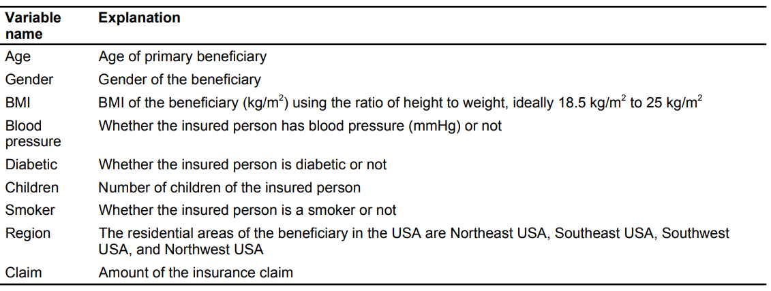
Data Exploration
USA health insurance claims by people aged 18 to 60 in four different regions
The data covers information about insurance claims, including age, gender, body mass index (BMI), blood pressure, diabetic status, number of children, smoking status as listed in the table below
Table 1

Slide 5
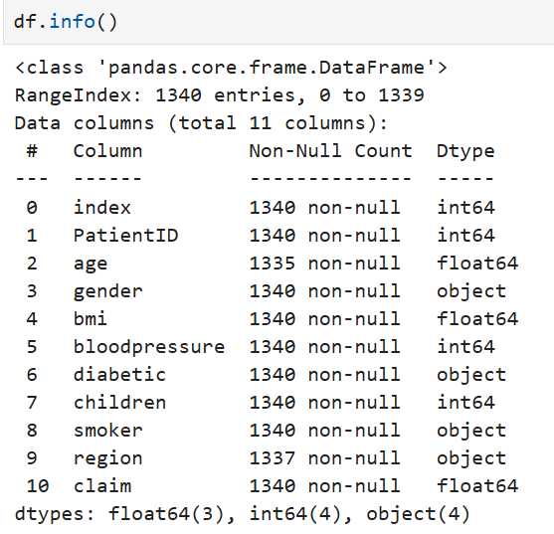
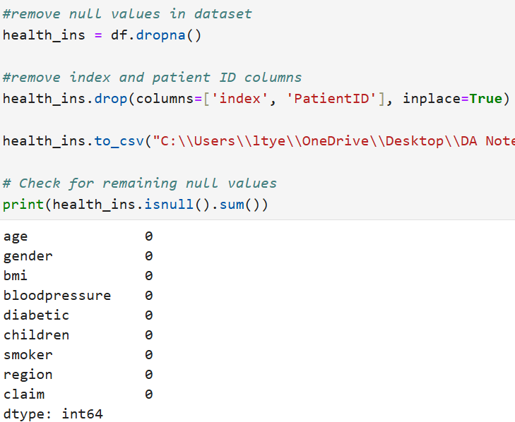
Data overview
The dataset originally consists of 1340 rows and 11 columns
Claim column was selected as the target variable
Removed the index and patient ID columns as well as null values from the dataset as seen in table 3
Data now consists of 1332 rows and 9 columns
Table 2
Table 3

Slide 6
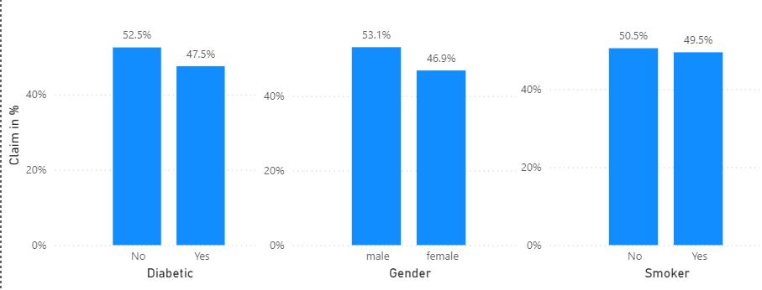
Data Analysis
Summary of category
Chart 1
Diabetic patients account for 47.5% of the claimants, nearly half, compared to nondiabetic patients at 52.5%
Male represents 50.3% and females slightly lower at 49.7% suggesting an almost even split in insurance claim ratios between the two genders
Smokers account for 49.5% and non-smokers 50.5% request for the insurance claim

Slide 7
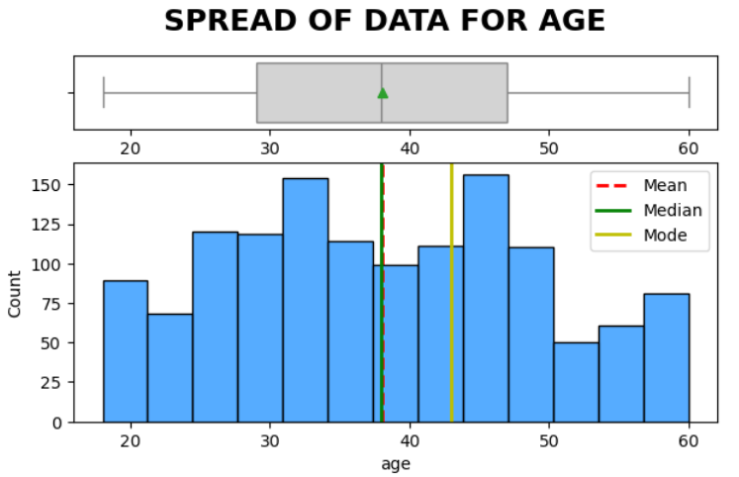
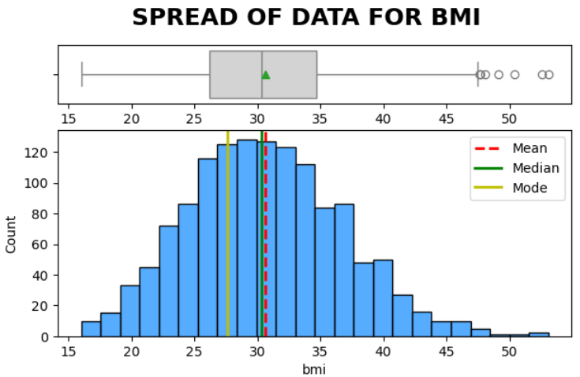
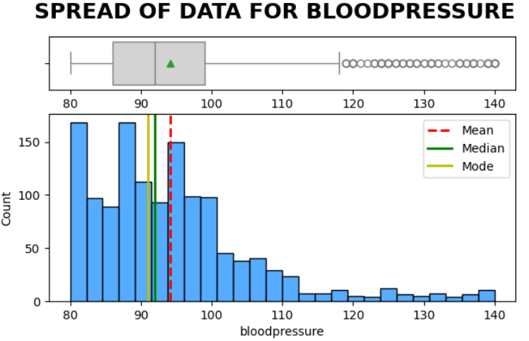
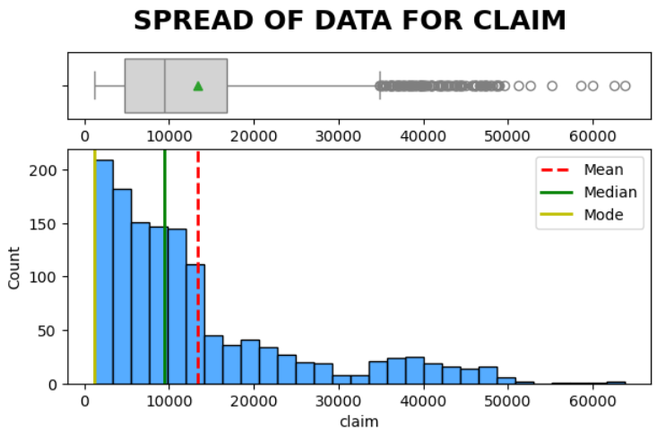
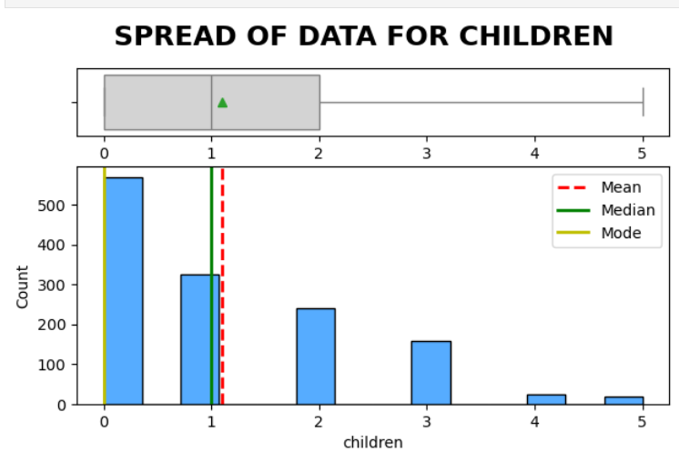
Data Analysis
The age distribution is even, with a slight increase among 30–40-year-olds
BMI is normally distributed with average BMI at 30, which is outside the normal range of BMI
Blood pressure & claim have higher positive skewness
Distribution of claims is right skewed which indicates a few high claimants in the dataset
There are also a lot of outliers at the upper end for BMI, blood pressure & claim
Most claimants have 0-3 children
Chart 2

Slide 8
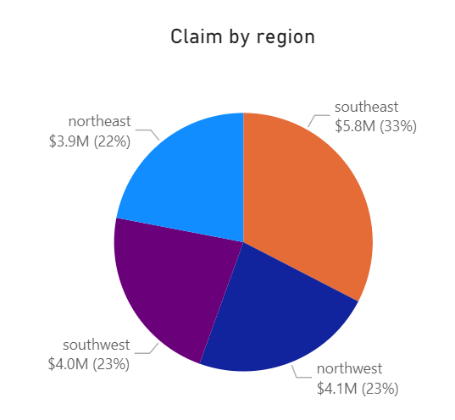
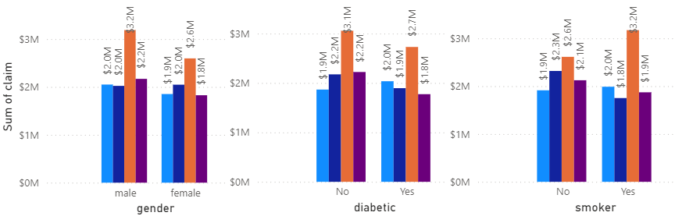
Data Analysis
Southeast USA region report the highest number of insurance claims, followed by those in the Northwest, Southwest, and Northeast (chart 3)
Northeast is less likely to file insurance claims than other regions
In Southeast men and smokers have higher claim amounts (chart 4)
Chart 3
Chart 4

Slide 9
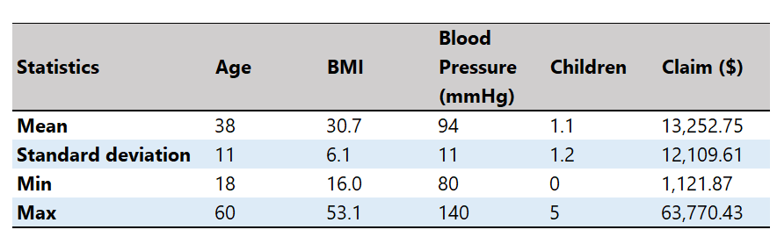
Data Analysis
Table 4
On average insurance claims are around $13,325
The wide range between minimum ($1,100) and maximum ($64,000) values shows significant variability in insurance claims

Slide 10
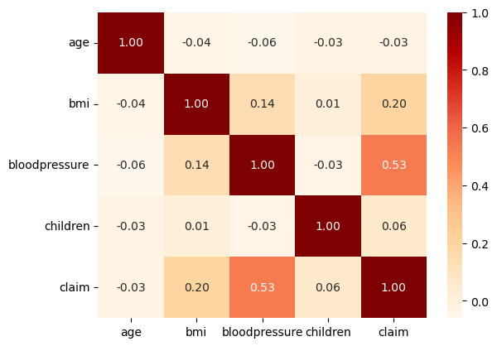
Data Analysis
Blood pressure has the strongest relationship with claim amounts
BMI also has a noticeable but weaker link with claims
Other variables, such as age and the number of children, show very weak or negligible relationships with claim amounts
Chart 5

Slide 11
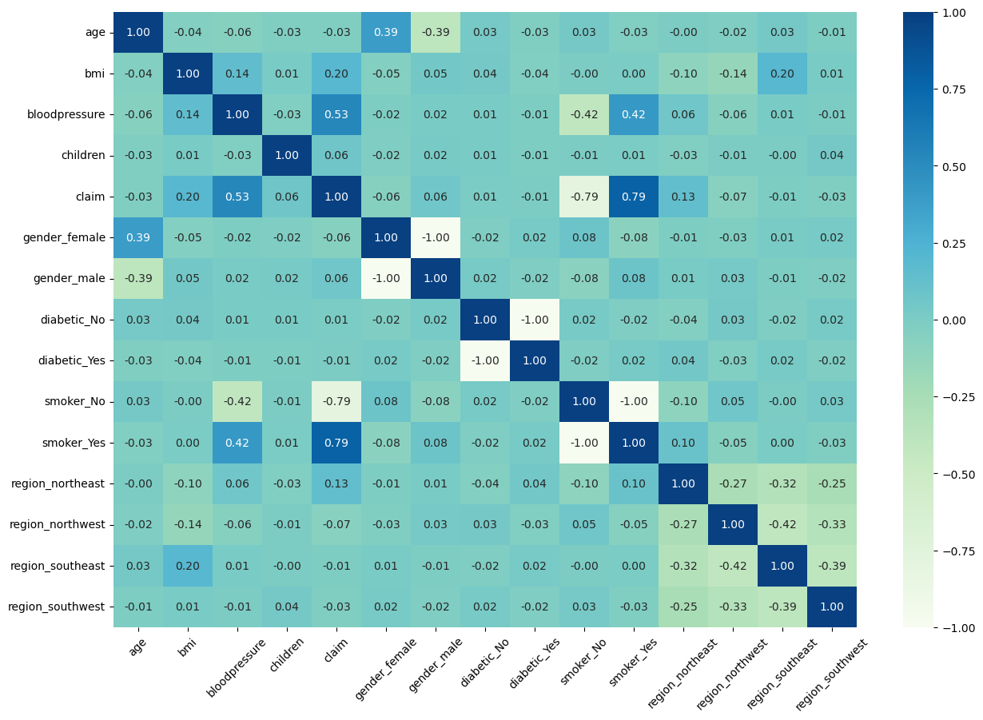
Data Analysis
The strong correlation between a smoker and claim amount indicates that smokers tend to have higher insurance claims
Smoker and blood pressure shows a moderate correlation, and this tends to shows that smokers have higher blood pressure compared to those who do not smoke
Chart 6
Chart 6

Slide 12
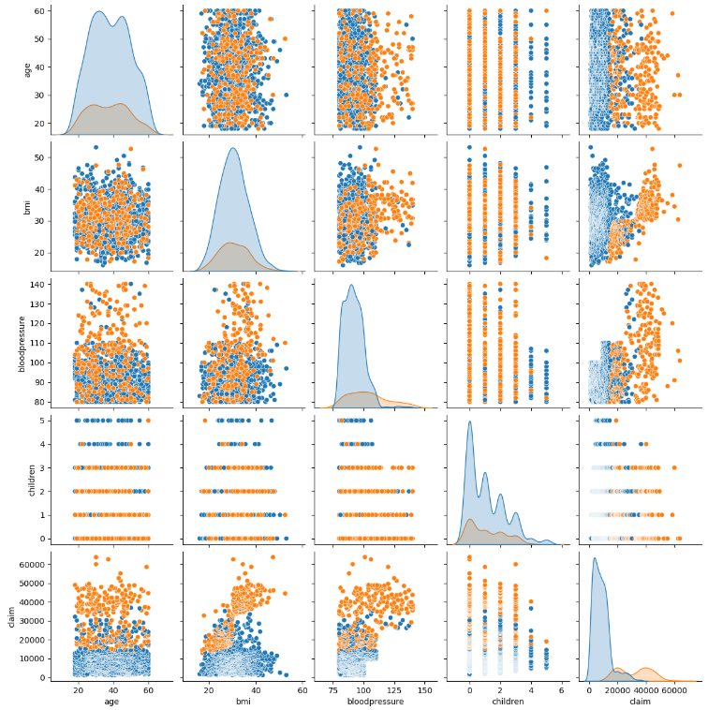
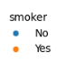
Data Analysis
Insurance claims are higher on average in smokers than non-smokers
Higher claims are associated with a higher BMI and claimants who smoke
Higher blood pressure is linked to higher claims
Chart 7

Slide 13
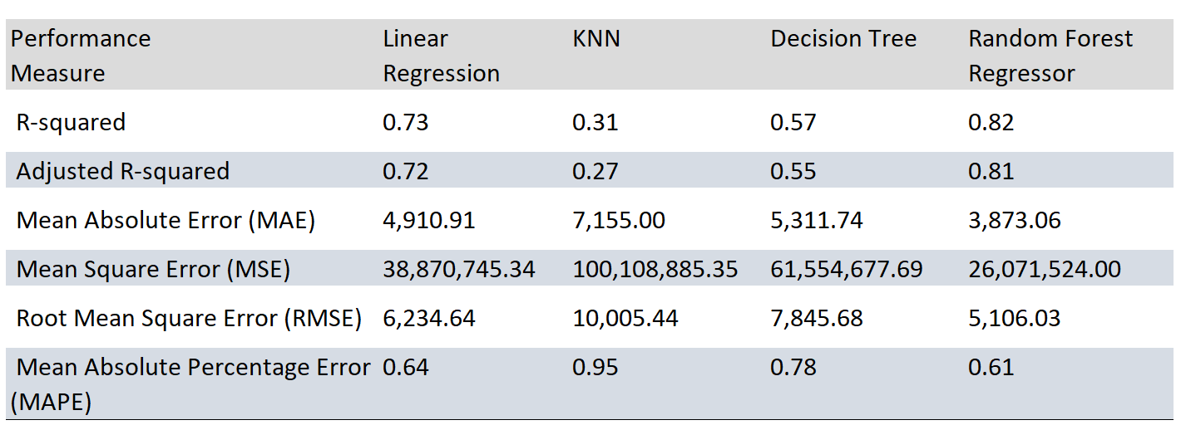
Model evaluation
Table 5

Slide 14
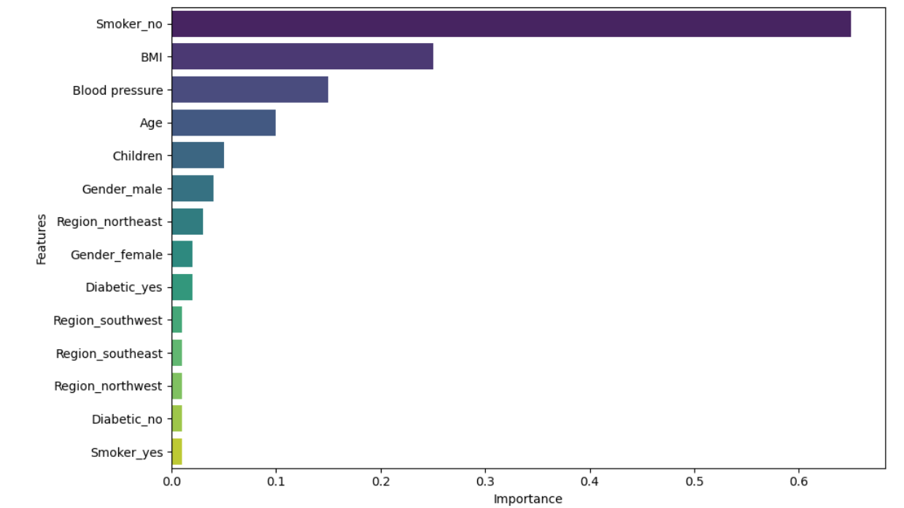
Model evaluation
Chart 8

Slide 15

Evaluation
The Random Forest Regressor (RFR) stands out against other models across all metrics, making it the most accurate and reliable for our dataset (table 5)
It provides reliable predictions with minimal error
Its high R-squared values and low MAPE underscore its effectiveness in capturing the complexity of the data..
RFR also recorded an MAPE of 0.61 which implies the lowest relative prediction error among the models
By computing feature importance, RFR determines each feature’s contribution to USA insurance claim prediction (chart 8)
Smoking is a very significant factor for insurance claims in the USA, followed by BMI and blood pressure

Slide 16
Key insights
Enhanced Decision-Making with AI:
The Random Forest Regressor (RFR) model enables more informed decisions in risk assessment, pricing strategies, and designing targeted health interventions through reliable predictions.
Critical Role of Key Variables:
The feature importance analysis highlights the significant impact of smoking habits, body mass index (BMI), and blood pressure on insurance claim predictions. These variables should be prioritized in formulating insurance policies and pricing strategies
Improved Efficiency and Cost Savings:
The application of AI, particularly the RFR model, enhances precision in predicting claims, reducing errors, and optimizing insurance claim processing. This can lead to substantial cost savings and improved efficiency within the healthcare insurance system.
Future Opportunities for AI in the USA Healthcare Sector:
By leveraging AI for insurance claim forecasting, the healthcare sector in the USA can significantly improve resource allocation, streamline processes, and ensure fair and accurate pricing strategies, driving progress in healthcare insurance.

Slide 17

Reflections
Challenges
What’s my angle?
How to not put everyone to sleep?
Find the right dataset
The small sample size increase sampling bias as the data might not accurately represent the population
What I’ve learnt
Debugging is no fun
How to present my story

Slide 18

Thank you
Linda Tye
Capstone Project
Jan 2025

